Slide 1
Creating an Accessible Physical Interface Development Toolkit
Jack Burnett
Pro² Summer School

Slide 2
About Me
Name: Jack Burnett
Role: Interactive AI PhD Student
Institute: University of Bristol
Focus: Hardware Design, Game Accessibility, and Co-Design

Slide 3
Table of contents
The Research
Why It’s Needed
01
02
Future Plans
Lessons Learnt
03
04
Overview of the research project
Examples of N-of-1 codesign issues
Next steps for the research
What I’ve learnt so far

Slide 4
01
The Research
Overview of the research project

Slide 5
— SCOPE
“66% of gamers with an impairment or condition say they face barriers or issues related to gaming.”

Slide 6
Definitions of Accessibility
Use
Creation
Player Priority
Ensures the game can be played by the players
Designer Priority
Allows for bespoke solutions to be created for users
Usability Focus
Compatibility and ease of use are primary ideals
Flexibility Focus
Modification and empowerment are central

Slide 7
The Research Idea
Notes
Create a simple way to design controller layouts
Focus on creating a toolkit for users to design their own controllers
Emphasising designing with, not for
Tools should be end-user friendly, rather than just for researchers
Create a method of generating controller PCBs
Create a method for optimising controller layouts
Identify the links between user data and controller preferences
Design a framework/guidelines for codesign of controllers

Slide 8
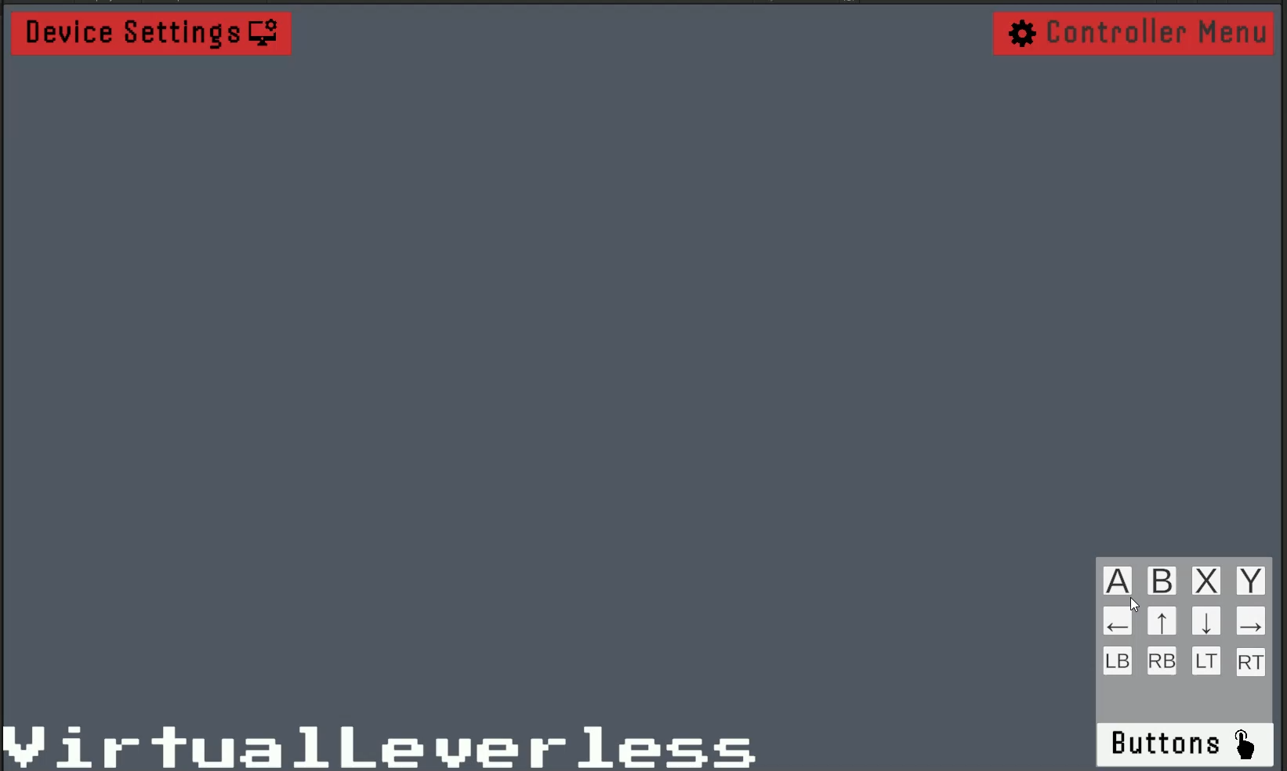
Virtual Layout Creation Tool

Slide 9
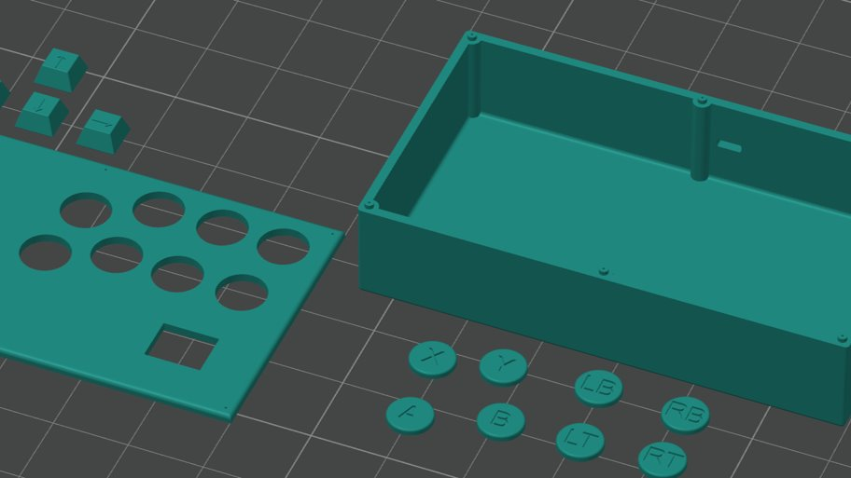
Controller Generation Tool

Slide 10
02
Why It’s Needed
Examples of N-of-1 codesign issues

Slide 11
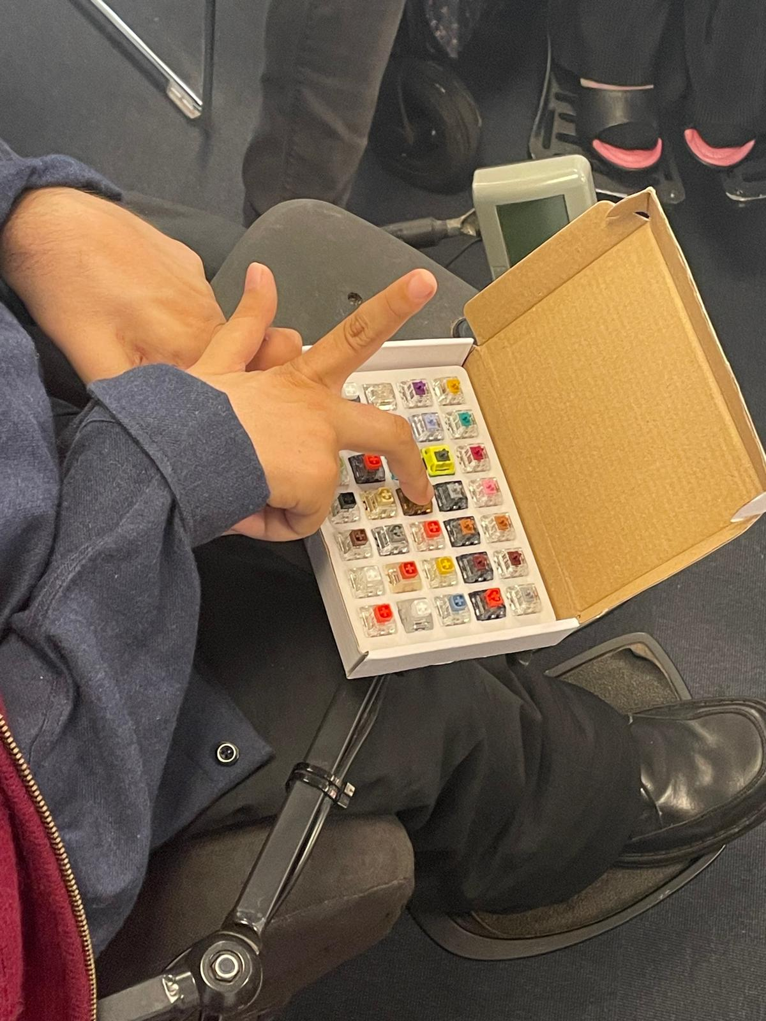
Testing Force Requirements

Slide 12
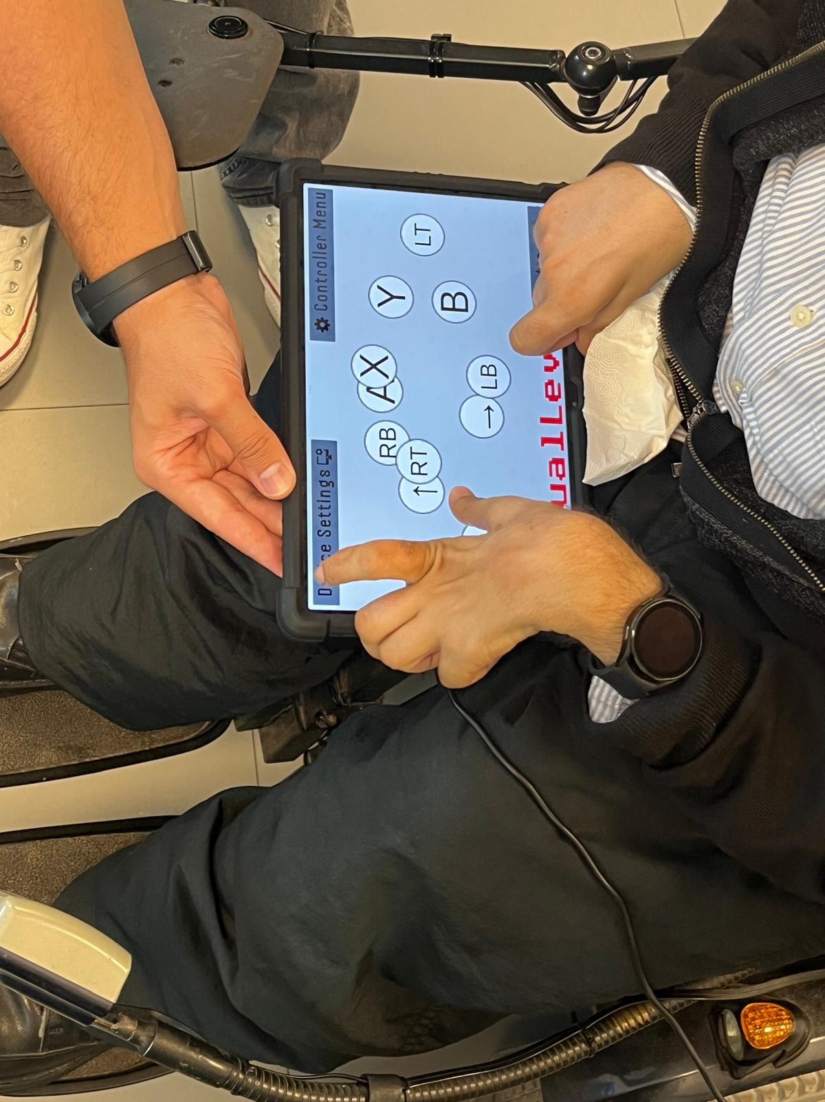
Creating a Layout

Slide 13
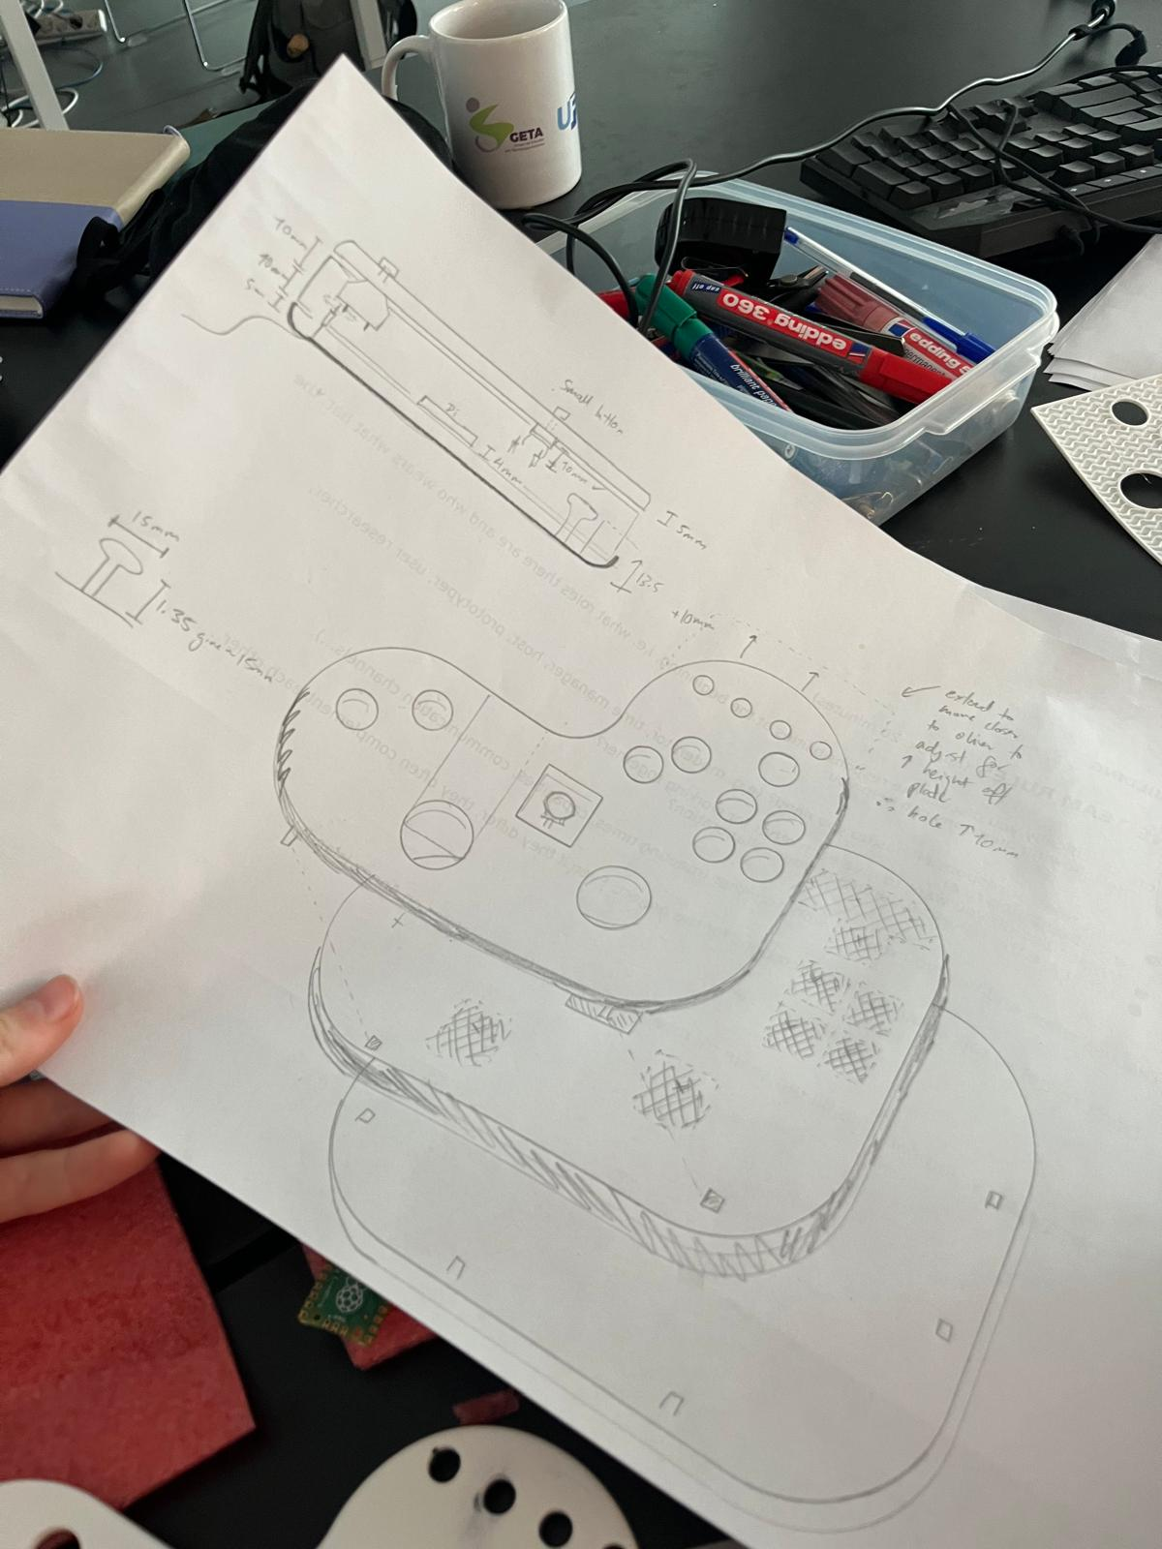
Design Sketches

Slide 14
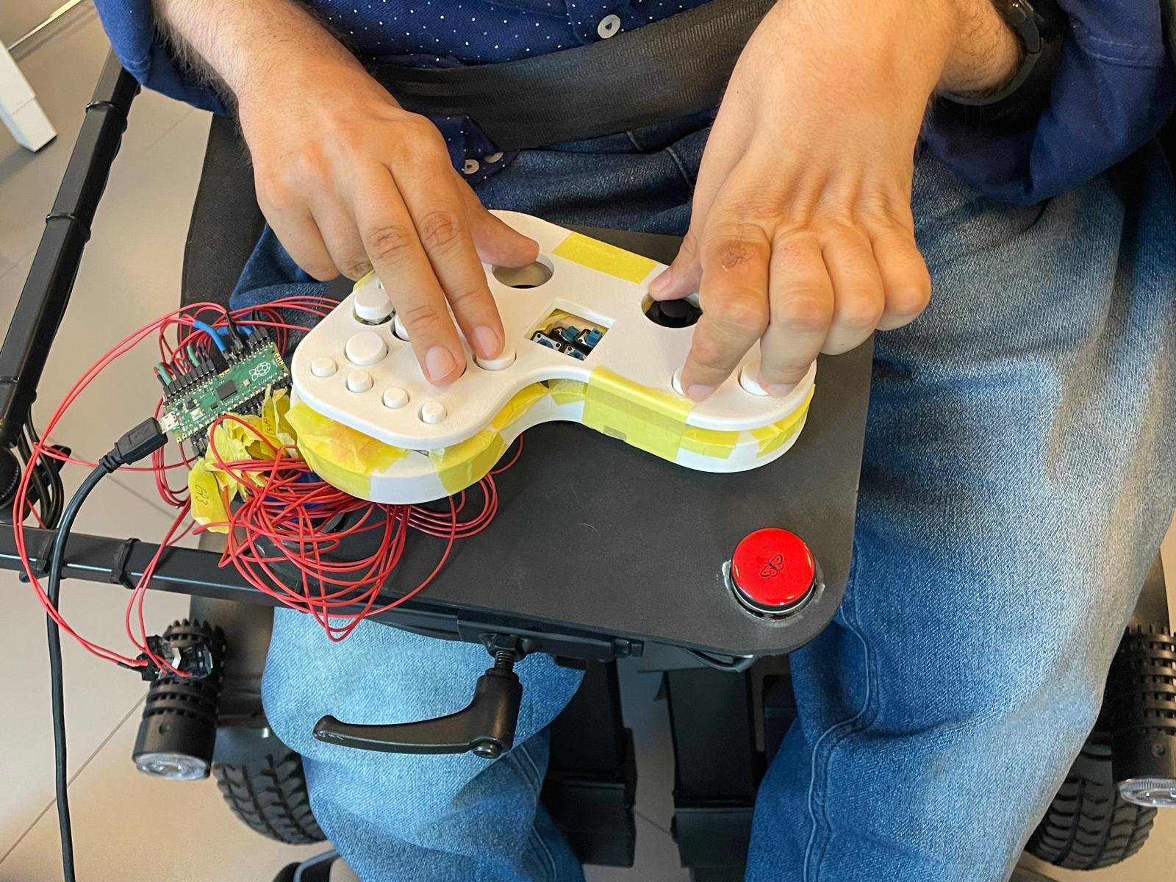
The Final Prototype

Slide 15
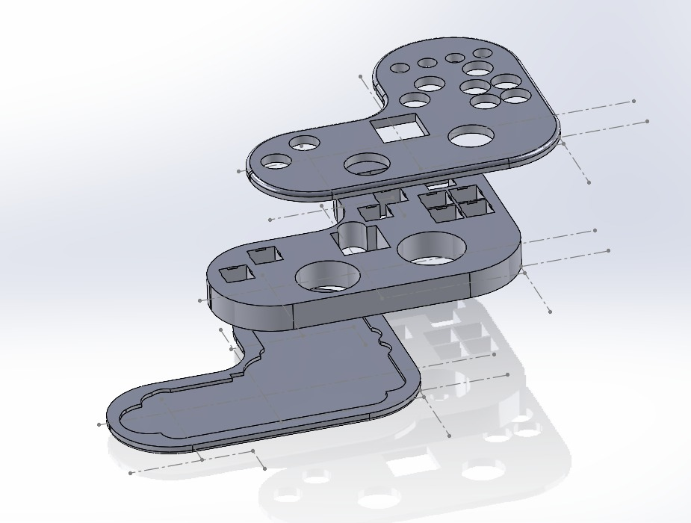
The Current Design

Slide 16
Co-Design is SLOW
Layouts
Hardware
Prototypes
Feel
CAD
Fine-tuning layouts after each round of testing
Rapidly prototyping with minimal waste
Each controller needs to be tested for efficiency
Joysticks, Switches, and controllers need in-situ testing
CAD design is time consuming even with the codesigner

Slide 17
Issues that hindered the co-design
Errors
Time
Prototypes
We designed for a RP2040 board with 1 less GPIO pin than required
Co-design relies on everyone’s schedule aligning and hoping no one is ill
Creating a functional prototype in less than 24 hours for testing needs perfect conditions

Slide 18
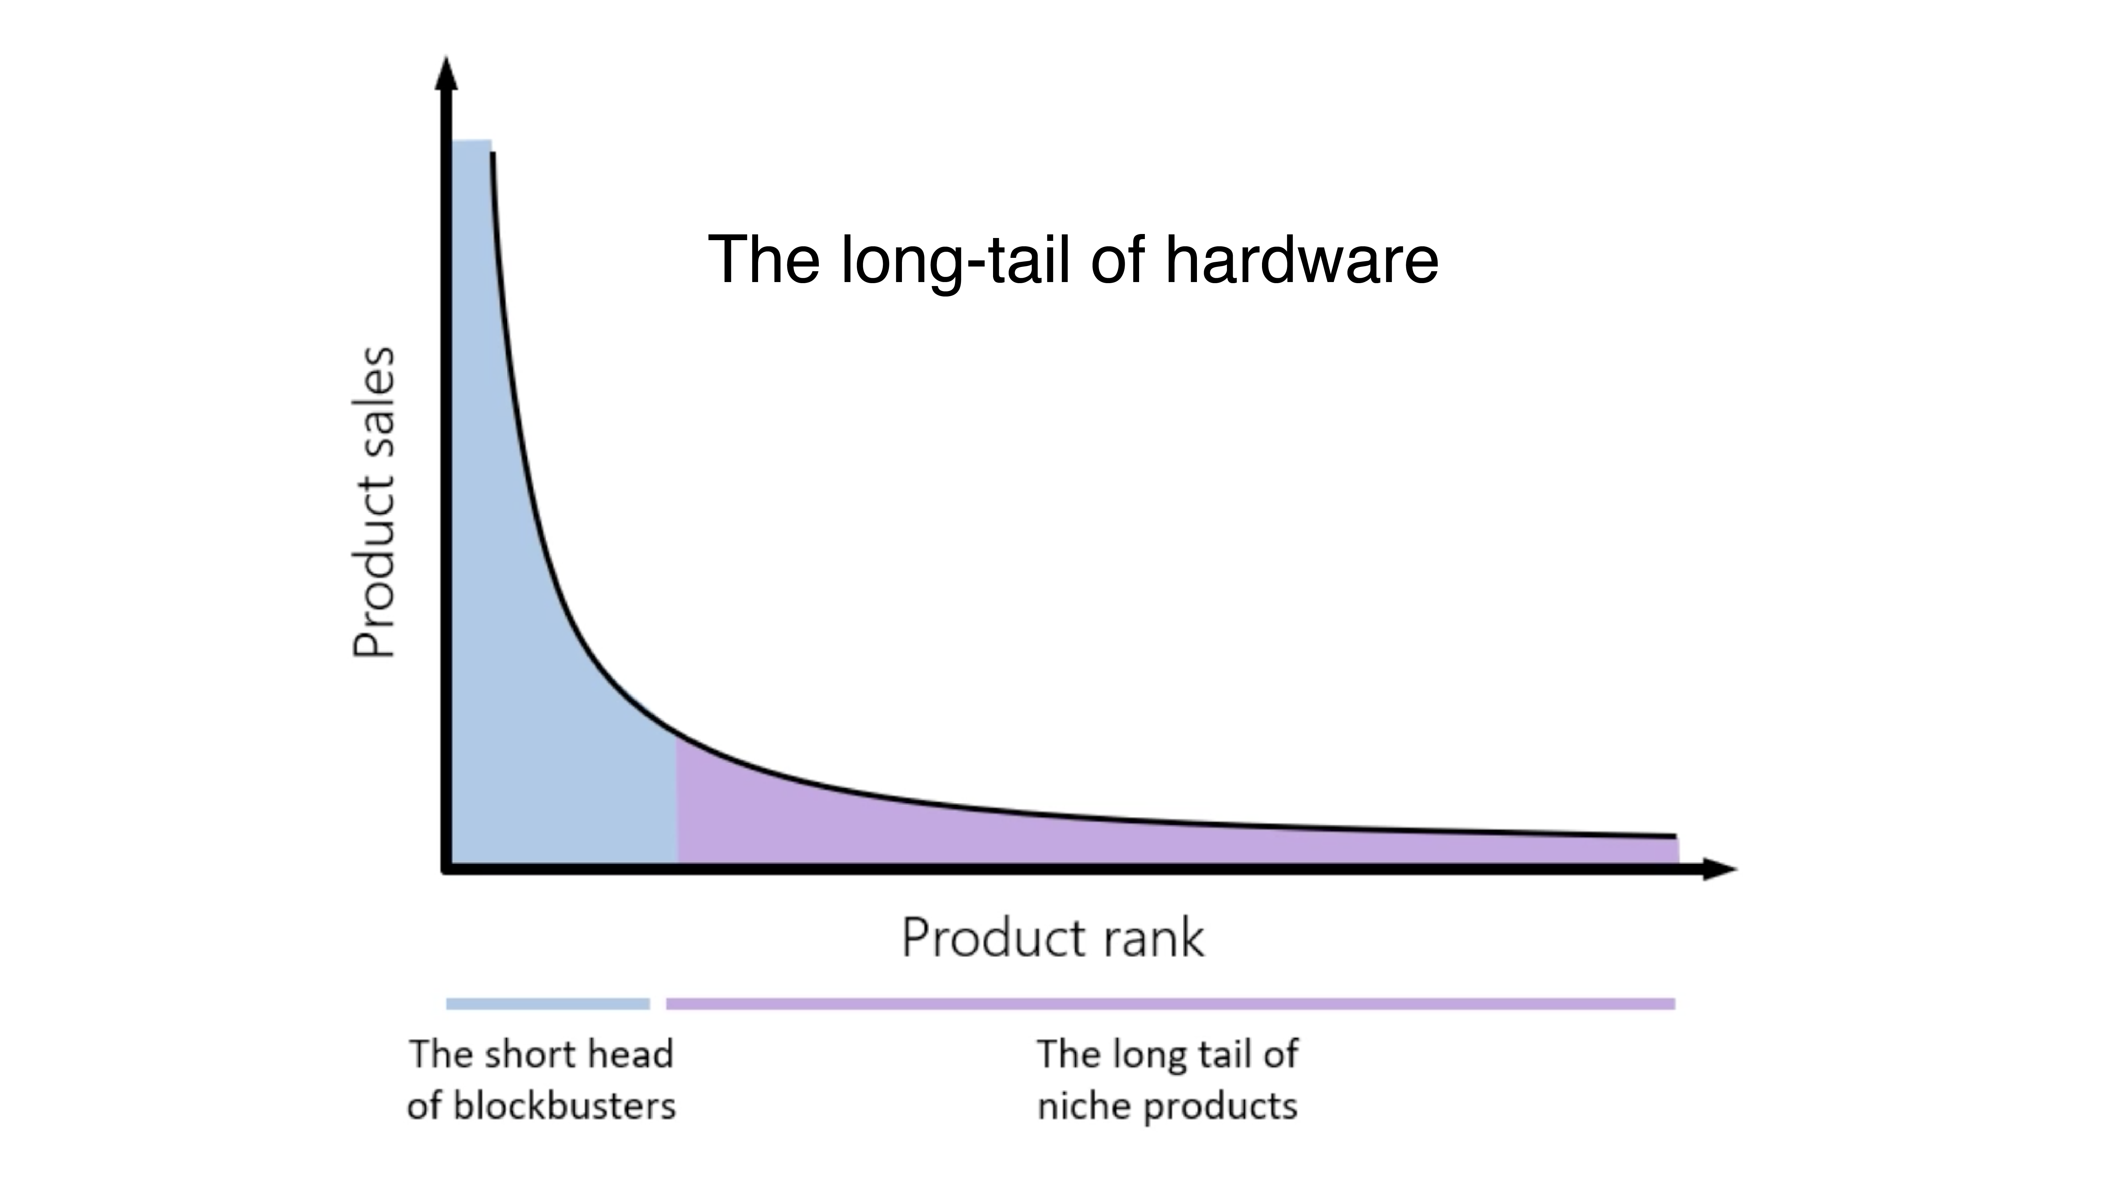
The Very End of Long Tail of Hardware

Slide 19
Future Plans
03
Next steps for the research

Slide 20
Current Plans
More Co-design
Finish the Toolkit
The research tools and the research itself rely on data from more co-design, both with designers and gamers with disabilities
The PCB generation software will be completed in the coming year, and hopefully released for testing

Slide 21
04
Lessons Learnt
What I’ve learnt so far

Slide 22
The Reality of Hardware Research
Belief
Reality
#1 | Everything will work
#2 | Users know what they want
#3 | Progress will be steady
#1 | Nothing ever works
#2 | Users very rarely know what they want
#3 | Progress comes in waves

Slide 23
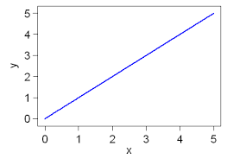
How I Expected The Research To Go
H a p p I n e s s
Time

Slide 24
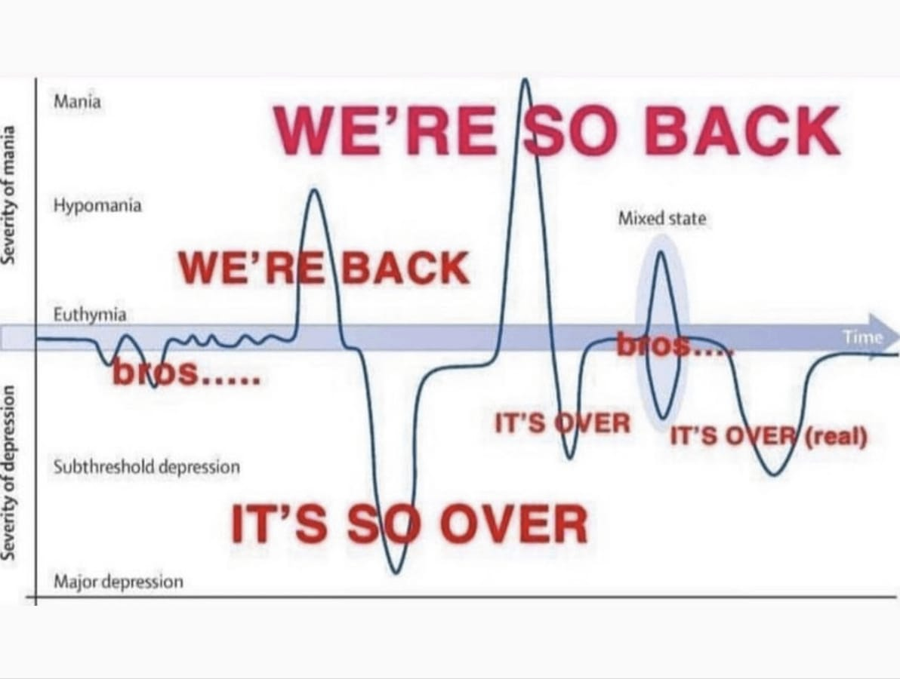
How The Research Went

